Slide 1

CSE 473: Pattern Recognition

Slide 2
Syntactic Pattern Recognition

Slide 3
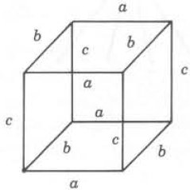
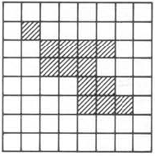
Capability of String Grammar
able to represent 1D pattern
difficult to classify patterns like these:

Slide 4
Capability of String Grammar
These structure contains
  information in both direction
  hierarchical structure

Slide 5
Capability of String Grammar
These structure contains
  information in both direction
  hierarchical structure
  Solution: Higher Order Grammar

Slide 6
Higher Order Grammar: Tree Grammar
Information is stored in
  nodes: as primitives or sub-structures
  edges: relation between primitives or sub-structures
Allows hierarchical decomposition of a complex structure

Slide 7
Representation using Tree (1)

Slide 8
Representation using Tree (1)
a
b
c
Primitives

Slide 9
Representation using Tree (1)
a
a
b
b
c
a
b
c
c
Primitives
c
c
b
a
b
a

Slide 10
Representation using Tree (1)
a
a
b
b
c
a
b
c
c
Primitives
c
c
b
a
b
S
a
a
b
c

Slide 11
Representation using Tree (1)
a
a
b
b
c
a
b
c
c
Primitives
c
c
b
a
b
S
a
a
b
c
b
c
c
a
a
b

Slide 12
Representation using Tree (1)
a
a
b
b
c
a
b
c
c
Primitives
c
c
b
a
b
S
a
a
b
c
b
c
c
a
a
b
c
a
b

Slide 13
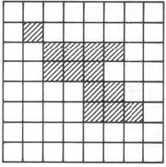
Representation using Tree (2)

Slide 14
Representation using Tree (2)
Primitives
Black region
White region
Gray region

Slide 15
Representation using Tree (2)
1
2
Primitives
3
4
1
2
3
4

Slide 16
Representation using Tree (2)
1
2
3
Primitives
1
2
3
4

Slide 17
Representation using Tree (2)
Primitives
1
2
3
4

Slide 18
Representation using Tree (2)
Primitives
1
2
3
4

Slide 19
Representation using Tree (2)
Primitives
1
2
3
4

Slide 20
Representation using Tree (2)
Primitives
1
2
3
4

Slide 21
Representation using Tree (2)
Primitives
1
2
3
4

Slide 22
Representation using Tree (2)
Primitives

Slide 23
Tree Traversal and Representation
Many methodologies
  DFS, BFS, . . .

Slide 24
Tree Traversal and Representation
Many methodologies
  DFS, BFS, . . .
0
0.2
0.1
0.2.3
0.2.1
0.2.2
0.2.2.2
0.2.2.1

Slide 25
Tree Traversal and Representation
Many methodologies
  DFS, BFS, . . .
T = {0, 0.1, 0.2, 0.2.1, 0.2.2, 0.2.3, 0.2.2.1, 0.2.2.2}
0
0.2
0.1
0.2.3
0.2.1
0.2.2
0.2.2.2
0.2.2.1

Slide 26
Tree Grammar
A tree grammar G_{T} is defined as
  G_{T}= {V, r, P, S}
  where
    P = set of productions involving trees
    V = V_{T} U V_{N}
    S= starting or root trees, T_{V}
    r = rank of a node

Slide 27
Tree Grammar
Rank of a node
  r(a) = 2
  r(b) = 3
  Therefore, this is out-degree of a node
a
b
c
f
d
e
k
g

Slide 28
Productions of Tree Grammar
Preserve the same structure but replace some terminal and/or non-terminals
A
a
C
C
B
b
a
a
b
C
b
c

Slide 29
Productions of Tree Grammar
Expansive form:
  X -> xX₁. . .X_{n}
x
X
r(x) = 2
Z
Y
A
b
r(b) = 0
C
c
r(c) = 0

Slide 30
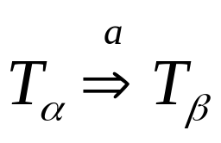
Derivation in a Tree Grammar
A derivation means:
k
k
a
a
c
c
F
f
d
E
d
e
T_{α}
T_{β}

Slide 31
Derivation in a Tree Grammar
A derivation means:
k
k
a
a
c
c
F
f
d
E
d
e
T_{α}
T_{β}
a
a
The production rule applied:
F
f
E
d
e
d

Slide 32
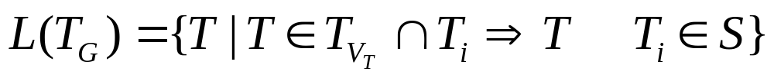
Language of A Tree Grammar

Slide 33
Stochastic Grammar
Formal grammars allow
  no error
  no ambiguity
  no structural deformation

Slide 34
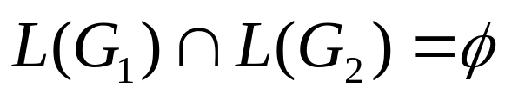
Stochastic Grammar
Formal grammars allow
  no error
  no ambiguity
  no structural deformation
In formal grammar,
Often this may be unrealistic

Slide 35
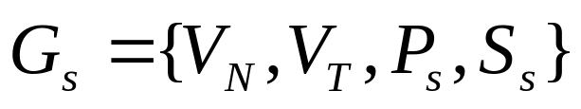
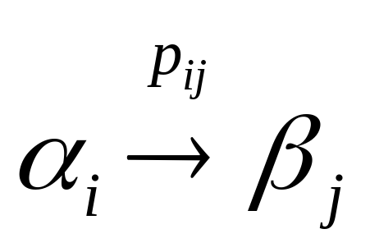
Stochastic Grammar
Stochastic grammar is defined as
The Production P_{s} is of the form

Slide 36
Stochastic Grammar
Stochastic grammar is defined as
The Production P_{s} is of the form
  because, there are multiple probabilistic consequents

Slide 37
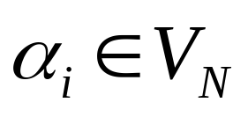
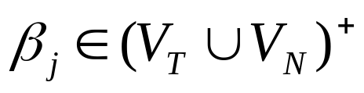

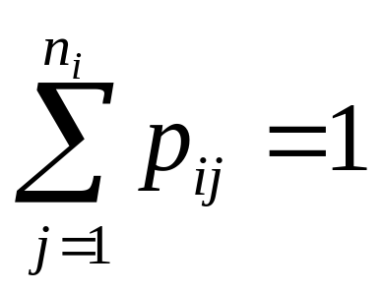
Proper Stochastic Grammar
A stochastic grammar is proper if
There exist n_{i} no. of so that

Slide 38
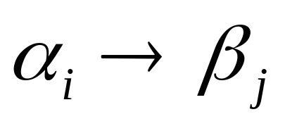
Characteristic Stochastic Grammar
A stochastic grammar is a characteristic grammar
  when probabilities are removed from the productions
that is, replaces

Slide 39
Classification of Stochastic Grammars
A stochastic grammar is classified based on its corresponding characteristic grammar:
  Type 0
  Type 1
  Type 2
  Type 3

Slide 40

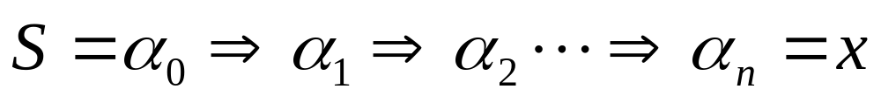
Derivation in Stochastic Grammar
Let there are m production rules, p^{i}, 1 <= i <= m
we need to derive:
in a number of n steps

Slide 41
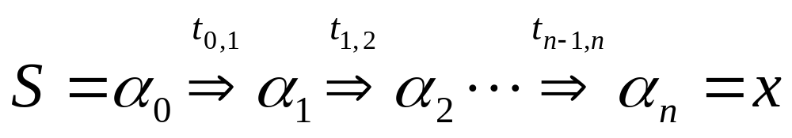
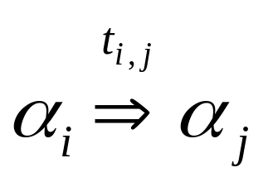
Derivation in Stochastic Grammar
Let there are m production rules, p^{i}, 1 <= i <= m
we need to derive:
in a number of n steps
where, t_{ij} is a production rule applied in the step

Slide 42
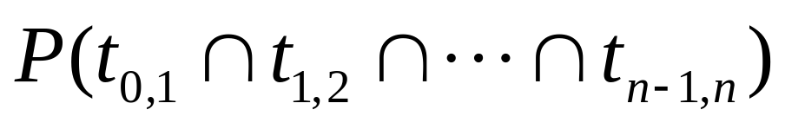
Derivation in Stochastic Grammar
The probability of generating
is

Slide 43
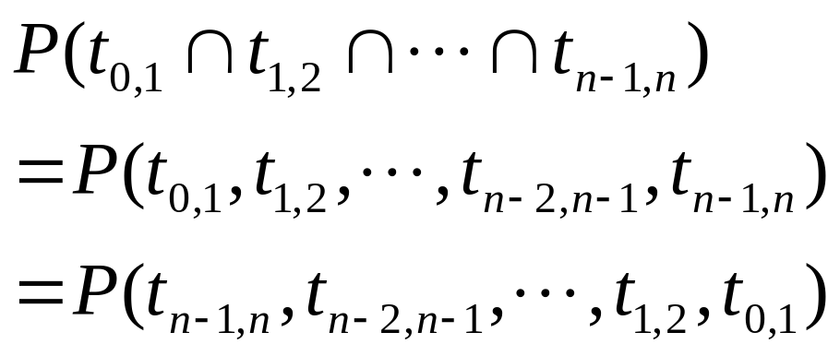
Derivation in Stochastic Grammar
The probability of generating
is

Slide 44
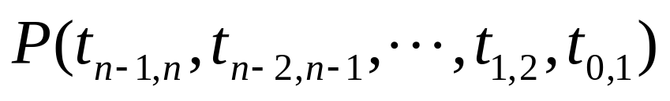
Derivation in Stochastic Grammar

Slide 45
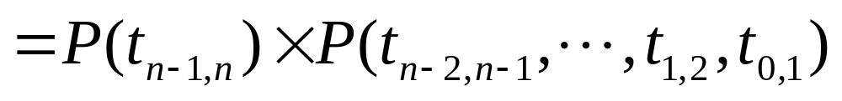
Derivation in Stochastic Grammar
Assumes that the probability of applying the next production is independent of previously applied productions

Slide 46
Derivation in Stochastic Grammar
Applying the same approach

Slide 47
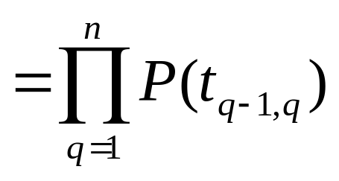
Derivation in Stochastic Grammar

Slide 48
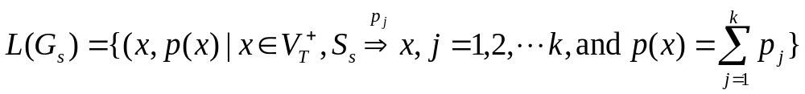
Stochastic Language
A stochastic language is of the form

Slide 49
Syntactic Pattern Recognition using
Graph Theory

Slide 50
Graphical Approaches to SyntPR
Graphical alternatives to represent structures or relational information
Natural extensions of higher dimensional grammars

Slide 51
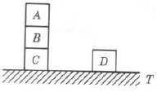
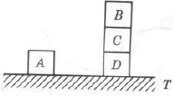
Graphical Description of Patterns
G_{w1}
G_{w2}
G_{u}

Slide 52
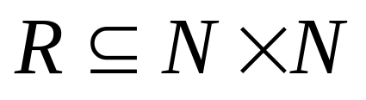
Graph Representation
A graph G = {N,R} is an ordered pair represented using:
  a set of nodes (vertices), N,
  a set of edges (arcs),

Slide 53


Graph Representation
A sub-graph G_{s} = {N_{s},R_{s}} is itself a graph, where
  , however, R_{s} consists of edgese that connects only the nodes in N_{s.}

Slide 54
Graph Representation

Slide 55
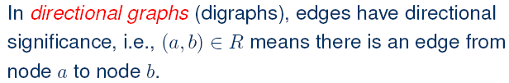
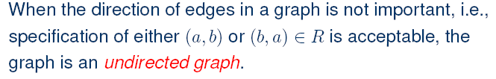
Other definitions related to Graph

Slide 56

Other definitions related to Graph

Slide 57
Classification Task by Comparing Relational Graph Descriptions
Naïve approach:
Represent each class as a prototypical relational graph
Convert unknown pattern to relational graph
Compare with the library of prototypes

Slide 58
Classification Task by Comparing Relational Graph Descriptions
The observed data rarely matches a stored relational representation “exactly”,
We need other approaches
  graph similarity should be measured.

Slide 59
Classification Task by Comparing Relational Graph Descriptions
One approach is to check whether the observed data match a “portion” of a relational model.
  Case 1: Any relation not present in both graphs is a failure.
  Case 2: Any single match of a relation is a success.
  A realistic strategy is somewhere in between these extremes.

Slide 60
Comparing Relational Graph Descriptions
We define some terms for graph similarity
  Use graph homomorphism and/or isomorphism

Slide 61

Graph Homomorphism
such that

Slide 62
Graph Isomorphism
A stricter term

Slide 63


Graph Isomorphism Test: Adjaceny Matrix

Slide 64
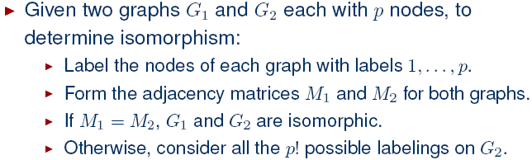
Graph Isomorphism Test

Slide 65
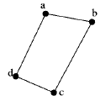
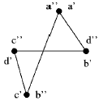
Graph Isomorphism Test

Slide 66


Graph Isomorphism Test

Slide 67

Graph Isomorphism Test
f(a’) = a”
f(b’) = d”
f(c’) = b”
f(d’) = c”

Slide 68
Graph Isomorphism Test
Computationally expensive
Allows only exact measure, not realistic
  Many relations may not be observed in practical examples

Slide 69
Graph Isomorphism Test: Quick Reject
Check for following properties
  Number of nodes
  Number of edges

Slide 70
Graph Isomorphism Test: Quick Reject
These are useful, too:
  in-degree i of a node
  out-degree j of a node
  degree k of a node (for undirected graph)
  closed path of length l

Slide 71
Alternate Graph Isomorphism Test: Sub-isomorphism

Slide 72

Alternate Graph Isomorphism Test: Sub-isomorphism

Slide 73


Extension to Graph Matching Approach

Slide 74
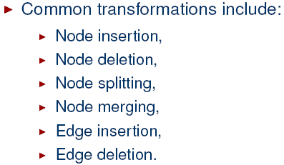
Extension to Graph Matching Approach

Slide 75
Extension to Graph Matching Approach
Computation is still high
Difficult to design a suitable distance measure to distinguish structural deformations

Slide 76
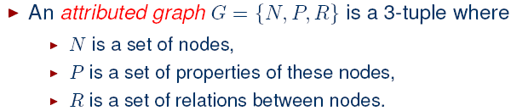
Extension to Graph Matching Approach

Slide 77

Matching Through Attributed Graph
Nodes n₁ ∈ N₁ and n₂ ∈ N₂ are said to form an assignment (n₁, n₂) if

Slide 78



Matching Through Attributed Graph

Slide 79
Matching Through Attributed Graph
n₂
n₁
n’₂
n’₁

Slide 80
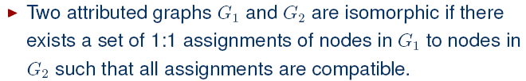
Matching Through Attributed Graph

Slide 81
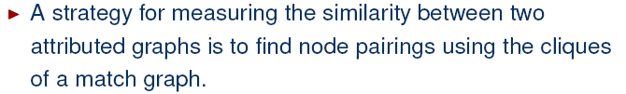
Matching Through Attributed Graph
G₁
G₂
Match Graph
Maximal Clique
Calculate Measure of Graph Similarity

Slide 82
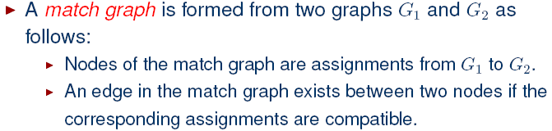

Matching Through Attributed Graph

Slide 83
Approaches in Matching Through Attributed Graph
Find
  the attributed graphs from the patterns
  the match graphs from the attributed graph
  the maximum clique from the match graph
  the similarity

Slide 84
Recursive Procedure to Find Cliques
Input:
  X: an initial clique (possibly empty)
  Y: the graph
Output:
  The set of all maximal cliques

Slide 85
Recursive Procedure to Find Cliques
Procedure clique (X, Y)
Form Y – X;
If a node y in Y – X is connected to all nodes of X,
Then return cliques (X U {y},Y) U cliques (X,Y-{y})
Else return X
End

Slide 86
Recursive Procedure to Find Cliques
Procedure clique (X, Y)
Form Y – X;
If a node y in Y – X is connected to all nodes of X,
Then return cliques (X U {y},Y) U cliques (X,Y-{y})
Else return X
End
a
d
b
c

Slide 87
Recursive Procedure to Find Cliques
Procedure clique (X, Y)
Form Y – X;
If a node y in Y – X is connected to all nodes of X,
Then return cliques (X U {y},Y) U cliques (X,Y-{y})
Else return X
End
Find clique (d, Y)?
a
d
b
c

Slide 88
Recursive Procedure to Find Cliques
Procedure clique (X, Y)
Form Y – X;
If a node y in Y – X is connected to all nodes of X,
Then return cliques (X U {y},Y) U cliques (X,Y-{y})
Else return X
End
clique (d, Y) = clique ({d, b}, Y) U
clique (d, {a, c, d})
a
d
b
c

Slide 89
Recursive Procedure to Find Cliques
Procedure clique (X, Y)
Form Y – X;
If a node y in Y – X is connected to all nodes of X,
Then return cliques (X U {y},Y) U cliques (X,Y-{y})
Else return X
End
clique (d, Y) = clique ({d, b}, Y) U
clique (d, {a, c, d})
clique ({d, b}, Y) = clique ({d, b, c}, Y) U
clique ({d, b}, {a, b, d})
a
d
b
c

Slide 90
Recursive Procedure to Find Cliques
Procedure clique (X, Y)
Form Y – X;
If a node y in Y – X is connected to all nodes of X,
Then return cliques (X U {y},Y) U cliques (X,Y-{y})
Else return X
End
clique (d, Y) = clique ({d, b}, Y) U
clique (d, {a, c, d})
clique ({d, b}, Y) = clique ({d, b, c}, Y) U
clique ({d, b}, {a, b, d})
a
d
{d, b}
b
c

Slide 91
Recursive Procedure to Find Cliques
Procedure clique (X, Y)
Form Y – X;
If a node y in Y – X is connected to all nodes of X,
Then return cliques (X U {y},Y) U cliques (X,Y-{y})
Else return X
End
clique (d, Y) = clique ({d, b}, Y) U
clique (d, {a, c, d})
clique ({d, b}, Y) = clique ({d, b, c}, Y)
U {d, b}
a
d
{d, b, c}
b
c

Slide 92
Recursive Procedure to Find Cliques
Procedure clique (X, Y)
Form Y – X;
If a node y in Y – X is connected to all nodes of X,
Then return cliques (X U {y},Y) U cliques (X,Y-{y})
Else return X
End
clique (d, Y) = clique ({d, b}, Y) U
clique (d, {a, c, d})
clique ({d, b}, Y) = {d, b, c} U {d, b}
a
d
b
c

Slide 93
Recursive Procedure to Find Cliques
Procedure clique (X, Y)
Form Y – X;
If a node y in Y – X is connected to all nodes of X,
Then return cliques (X U {y},Y) U cliques (X,Y-{y})
Else return X
End
clique (d, Y) = clique ({d, b}, Y) U
clique (d, {a, c, d})
clique ({d, b}, Y) = {d, b, c} U {d, b}
= {d, b, c}
a
d
b
c

Slide 94
Recursive Procedure to Find Cliques
Procedure clique (X, Y)
Form Y – X;
If a node y in Y – X is connected to all nodes of X,
Then return cliques (X U {y},Y) U cliques (X,Y-{y})
Else return X
End
clique (d, Y) = {d, b, c} U {d, b} U
clique (d, {a, c, d})
a
d
b
c

Slide 95
Recursive Procedure to Find Cliques
Procedure clique (X, Y)
Form Y – X;
If a node y in Y – X is connected to all nodes of X,
Then return cliques (X U {y},Y) U cliques (X,Y-{y})
Else return X
End
clique (d, Y) = {d, b, c} U {d, b} U
clique (d, {a, c, d})
clique (d, {a, c, d})
= clique ({d, c}, {a, c, d})
U clique (d, {a, d})
a
d
b
c

Slide 96
Recursive Procedure to Find Cliques
Procedure clique (X, Y)
Form Y – X;
If a node y in Y – X is connected to all nodes of X,
Then return cliques (X U {y},Y) U cliques (X,Y-{y})
Else return X
End
clique (d, Y) = {d, b, c} U {d, b} U
clique (d, {a, c, d})
clique (d, {a, c, d})
= clique ({d, c}, {a, c, d})
U clique (d, {a, d})
={d, c} U {d}
a
d
b
c

Slide 97
Recursive Procedure to Find Cliques
Procedure clique (X, Y)
Form Y – X;
If a node y in Y – X is connected to all nodes of X,
Then return cliques (X U {y},Y) U cliques (X,Y-{y})
Else return X
End
clique (d, Y) = {d, b, c} U {d, b}
U {d, c} U {d}
a
d
b
c

Slide 98
Recursive Procedure to Find Cliques
Procedure clique (X, Y)
Form Y – X;
If a node y in Y – X is connected to all nodes of X,
Then return cliques (X U {y},Y) U cliques (X,Y-{y})
Else return X
End
The maximal clique is = {d, b, c}
a
d
b
c

Slide 99
Example: Pattern Matching Using Attributed Graph
P
T

Slide 100
Example: Pattern Matching Using Attributed Graph
P
T
Reference
Reference

Slide 101
Example: Pattern Matching Using Attributed Graph
P
T
Reference
Test
Reference

Slide 102
Example: Pattern Matching Using Attributed Graph
Find Attributed Graph for all patterns
a
a
e
d
b
b
c
d
e
c
AG
l₁
l₁
Horizontal line
Vertical line
Relation: connected

Slide 103
Example: Pattern Matching Using Attributed Graph
Find Attributed Graph for all patterns
a
a
a’
b’
e
b
a’
d
c’
d’
b
b’
c
d
e
c
d’
AG
c’
l₁
l₁
l₂
AG
l₂
a”
a”
b”
b”
Horizontal line
Vertical line
Relation: connected
c”
c”
u
AG_{u}

Slide 104
Example: Pattern Matching Using Attributed Graph
Find Matched Graph between AGl₁ and AG_{u}
a
a”
e
b”
b
d
c”
c
AG
AG_{u}
l₁

Slide 105
Example: Pattern Matching Using Attributed Graph
Find Matched Graph between AGl₁ and AG_{u}
a
a”
e
Find all assignments between AGl₁ and AG_{u}:
(a, a”), (b, b”), (b, c”), (c, a”),
(d, b”), (d, c”), (e, b”), (e, c”)
b”
b
d
c”
c
AG
AG_{u}
l₁

Slide 106
Example: Pattern Matching Using Attributed Graph
Find Matched Graph between AGl₁ and AG_{u}
a
a”
a, a”
e
e, c”
b”
b
e, b”
b, b”
d
c”
c
AG
AG_{u}
l₁
d, c”
b, c”
d, b”
c, a”
Find all assignments between AGl₁ and AG_{u}

Slide 107
Example: Pattern Matching Using Attributed Graph
Find Matched Graph between AGl₁ and AG_{u}
a
a”
a, a”
e
e, c”
b”
b
e, b”
b, b”
d
c”
c
AG
AG_{u}
l₁
d, c”
b, c”
d, b”
c, a”
Connect the compatible assignments

Slide 108
Example: Pattern Matching Using Attributed Graph
Find Matched Graph between AGl₁ and AG_{u}
a
a”
a, a”
e
e, c”
b”
b
e, b”
b, b”
d
c”
c
AG
AG_{u}
l₁
d, c”
b, c”
a, a”
e, c”
d, b”
c, a”
Find the maximal clique: {(a, a”),(d, b”), (e, c”)}
d, b”

Slide 109
Example: Pattern Matching Using Attributed Graph
Find Matched Graph between AGl₁ and AG_{u}
a
a”
a, a”
e
e, c”
b”
b
d
c”
c
AG
AG_{u}
l₁
d, b”
(a, a”)
(d, b”)
Visual Representation
(e, c”)

Slide 110
Example: Pattern Matching Using Attributed Graph
Find Matched Graph between AGl₁ and AG_{u}
a’
a”
d’
b’
b”
c’
c”
AG
AG_{u}
l₂

Slide 111
Example: Pattern Matching Using Attributed Graph
Find Matched Graph between AGl₁ and AG_{u}
a’
a”
d’
Find all assignments between AGl₂ and AG_{u}:
(a’, a”), (b’, a”), (c’, b”),
(c’, c”), (d’, b”), (d’, c”)
b’
b”
c’
c”
AG
AG_{u}
l₂

